Slide 1

VGP104 - Software Development and Testing
Instructor: Peter Chan

Slide 2
Agenda
Agile Software Development
Scrum
Rule #8 - Get a Fresh View

Slide 3
Agile Software Development
A group of software development methodologies based on iterative and incremental development
Requirements and solutions evolve through collaboration between self-organizing, cross-functional teams
Promotes adaptive planning, evolutionary development and delivery, a time-boxed iterative approach, and encourages rapid and flexible response to change

Slide 4
Agile Manifesto
Published in 2001 by 17 software developers aimed at defining the approach to Agile Software Development
The manifesto stated the following values:
    - Individuals and interaction over processes and tools
    - Working software over comprehensive documentation
    - Customer collaboration over contract negotiation
    - Responding to change over following a plan

Slide 5
Agile Manifesto
    Individuals and interaction
        In agile, self-organizing and motivation are important, as are interactions like co-location and pair programming
    Working software
        Working software will be more useful and welcome than just presenting documents to clients in meetings

Slide 6
Agile Manifesto
    Customer collaboration
        Requirements cannot be fully collected at the beginning of the software development cycle, therefore continuous customer or stakeholder involvement is very important
    Responding to change
        Agile development is focused on quick responses to change and continuous development

Slide 7
Agile Manifesto
The twelve principles:
  Customer satisfaction by rapid delivery of useful software
  Welcome changing requirements, even late in development
  Working software is delivered frequently (weeks rather than months)
  Working software is the principal measure of progress
  Sustainable development, able to maintain a constant pace
  Close, daily co-operation between business people and developers

Slide 8
Agile Manifesto
The twelve principles (continued):
  Face-to-face conversation is the best form of communication (co-location)
  Projects are built around motivated individuals, who should be trusted
  Continuous attention to technical excellence and good design
  Simplicity
  Self-organizing teams
  Regular adaptation to changing circumstances

Slide 9
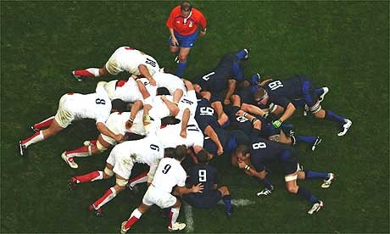
Scrum

Slide 10
Scrum
Scrum is an agile software development methodology invented in 1993
One of the most popular methodologies and is widely adopted by many game studios
Scrum is a process skeleton that contains sets of practices and predefined roles

Slide 11
Scrum Roles
Scrum Master - maintains the processes, facilitates the daily scrum meetings and manage impediments
Product Owner - represents the stakeholders and the business, manages requirements, provide details and priorities
Team - cross-functional group who do the actual analysis, design, implementation, and testing

Slide 12
Sprint
The basic unit of development in Scrum each can last up to one to four weeks
Begins with a planning meeting, where tasks are drawn from the product backlog and assigned to team members and estimates are made
Daily standup meetings are held where the team members answer three questions.

Slide 13
Sprint
Daily standup meeting questions:
    - What have you done yesterday?
    - What are you planning to do today?
    - Are there any impediments/blockers?
Review meetings are held at the end of each sprint to review the work that was completed, requirements might be adjusted and the cycle repeats

Slide 14
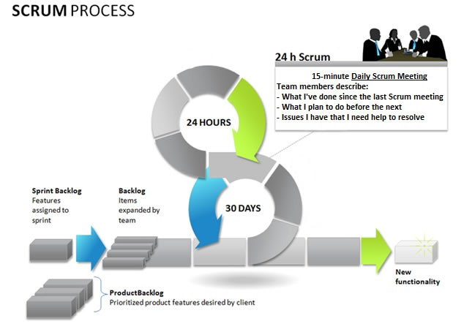
Scrum

Slide 15
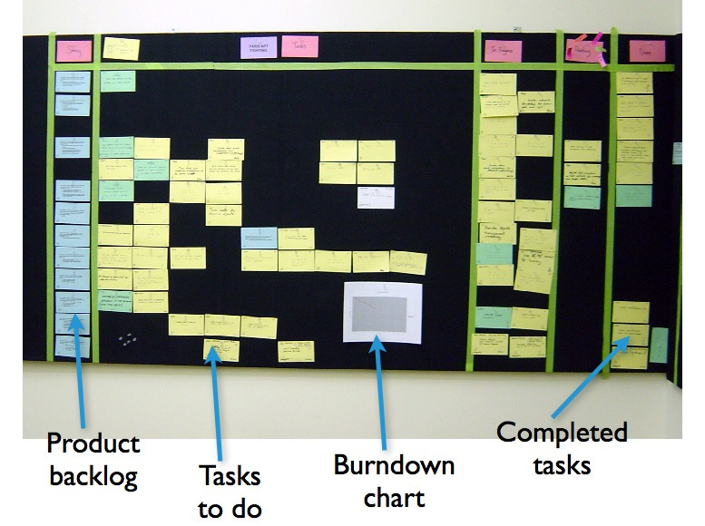
Scrum

Slide 16
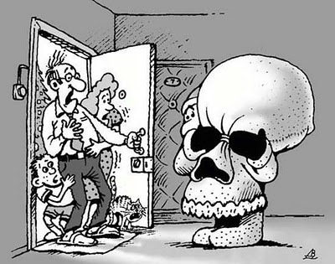
Rule #8 - Get a Fresh View

Slide 17
Rule #8 - Get a Fresh View
Sometimes you might be stuck at a problem for a long time, it could be because of bad assumptions, incomplete knowledge of the system, or you are simply too tired
When it seems like you have tried everything and nothing worked, you should ask for help
There are at least three reasons to ask for help: a fresh view, expertise, and experience

Slide 18
A Breath of Fresh Insight
  We all have biases about everything, including where a bug is hiding
  Someone who comes at the problem from an unbiased viewpoint can give us great insights and trigger new approaches
  In fact, sometimes explaining the problem to someone else gives you a fresh view

Slide 19
Ask an Expert
  There are occasions where a part of the system is a mystery to us and it takes hours to try to learn about it
  Instead we can ask an expert and learn what we need to know quickly in order to solve a problem
  An expert "Understand the System" better than we do and can help speed up the search, he can also help design a proper fix that ensure the stability of the rest of the system

Slide 20
The Voice of Experience
  There may be people around you who have seen a similar problem before
  Given a quick description of what's going on, they may be able to tell you exactly what's wrong
  Even if they can't give you an answer, they may at least point you in the right direction or where to look

Slide 21
Report Symptoms, Not Theories
  Keep this in mind when you report a problem
  The reason you ask for fresh insight is that your theories aren't getting you anywhere
  If you go to somebody and lay a theory on him/her, you drag them right down into the same rut you are in
  You might also hide some key details that he/she needs to know

